Slide 1
Practical Implementation on Linear & Multiple Regression Analysis

Slide 2
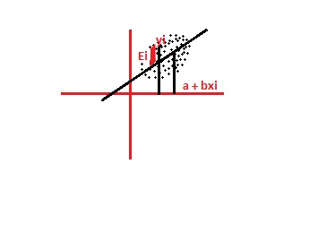
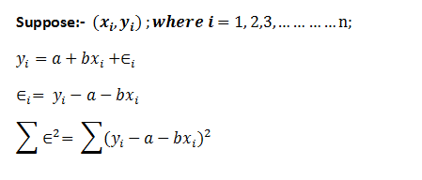

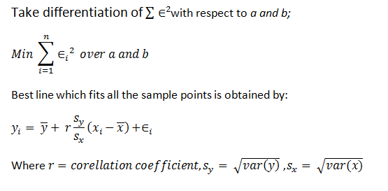


Concept of Linear Regression

Slide 3
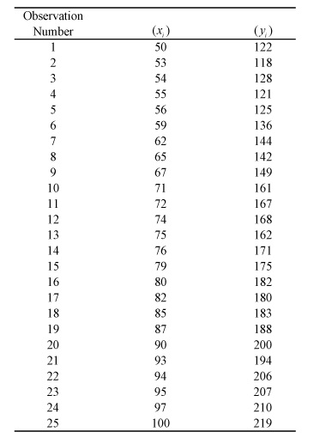
Given Example

Slide 4
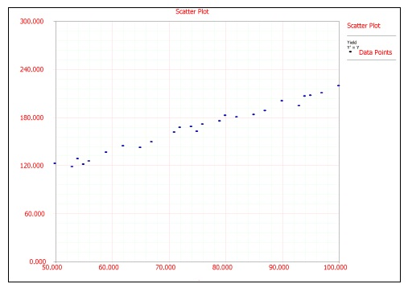
Scatter Plot of given data set

Slide 5
No of observation | x | y | xy | x² | y²
1 | 50 | 122 | 6100 | 2500 | 14884
2 | 53 | 118 | 6254 | 2809 | 13924
3 | 54 | 128 | 6912 | 2916 | 16384
4 | 55 | 121 | 6655 | 3025 | 14641
5 | 56 | 125 | 7000 | 3136 | 15625
6 | 59 | 136 | 8024 | 3481 | 18496
7 | 62 | 144 | 8928 | 3844 | 20736
Σ | 389 | 894 | 49873 | 21711 | 114690

Slide 6
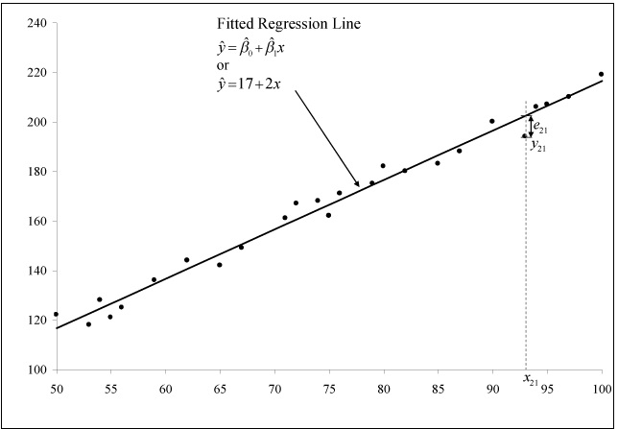
Fitted Regression Curve

Slide 7
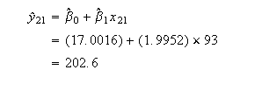

Calculating Error
Once the fitted regression line is known, the fitted value of corresponding to any observed data point can be calculated. For example, the fitted value corresponding to the 21st observation in above Table is:
The observed response at this point is y₂₁ = 194 Therefore, the residual at this point is:

Slide 8
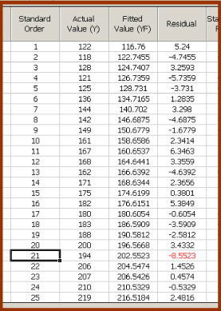
Calculated Error Table

Slide 9
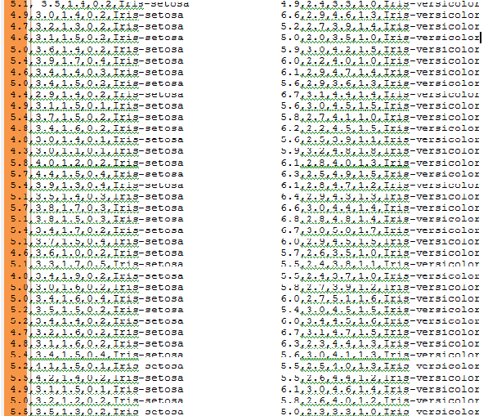
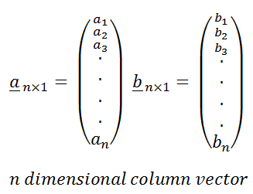
IRIS Dataset Description

Slide 10
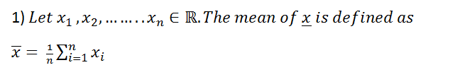
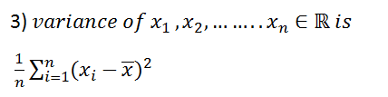
Simple Linear Regression on IRIS data set

Slide 11
